Slide 1
Cabling

Slide 2
Contents
Introduction
Types of cables
Cabling Standards 568A vs. 568B
Straight through and cross over cable
Tools for cabling
Connectors

Slide 3
Introduction
In computer networks, cables are the physical medium that enables data to be transmitted between devices. They form the backbone of network infrastructure, facilitating communication between computers, servers, routers, switches, and other network devices. Cables come in various types, each suited for specific network requirements based on factors like data transfer speed, distance, and environmental conditions.
There are generally two types of Signals used:
Baseband
Baseband signaling involves transmitting digital signals directly over a communication medium without modulating them into analog form. In baseband transmission, the entire bandwidth of the medium is used to transmit a single digital signal.
Broadband
Broadband signaling involves modulating digital signals into analog form and transmitting them over a wide range of frequencies simultaneously. This allows multiple signals to be transmitted over the same medium concurrently.
Analog signals are continuous, represented by smoothly varying voltages or frequencies, while digital signals are discrete, represented by sequences of discrete values (0s and 1s), offering better noise immunity and precise representation of data.

Slide 4
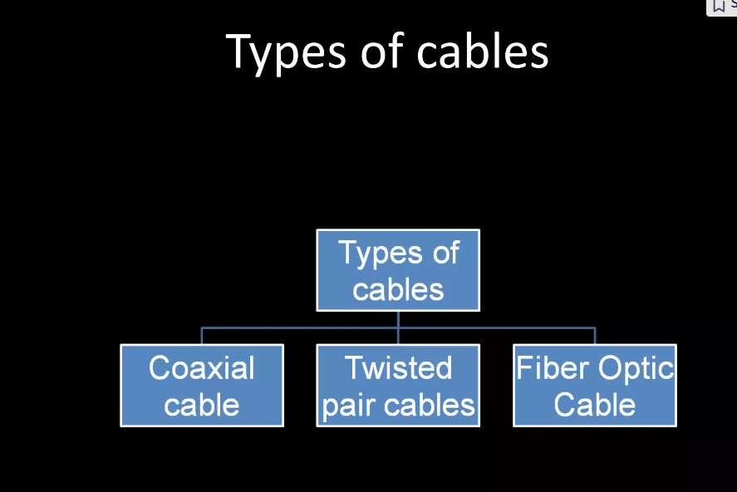
Types of cables

Slide 5
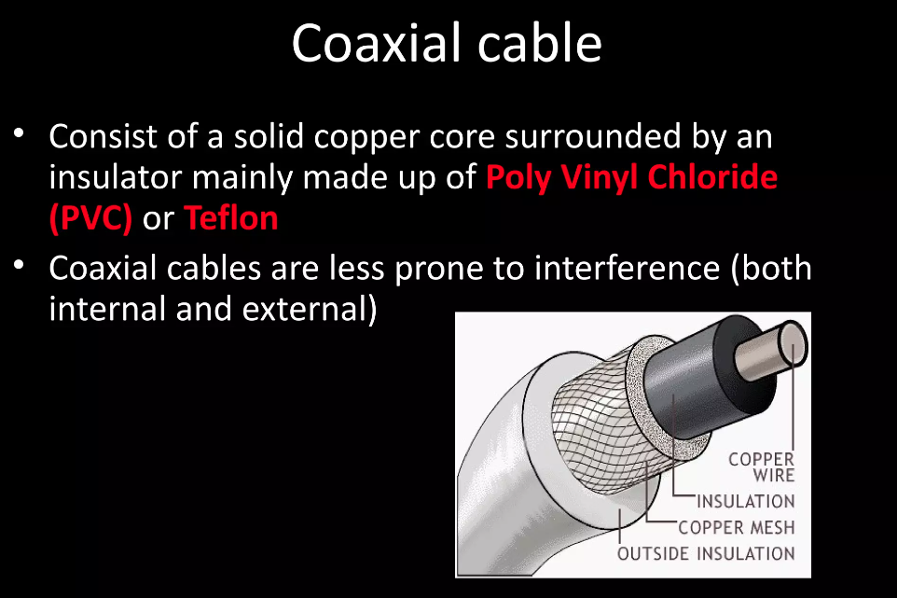
Coaxial cable
A coaxial cable is a type of electrical cable consisting of an inner conductor, insulating layer, metallic shield, and outer insulating layer, commonly used for transmitting high-frequency signals such as cable television and internet. It's characterized by its cylindrical shape and ability to carry signals with minimal interference.

Slide 6
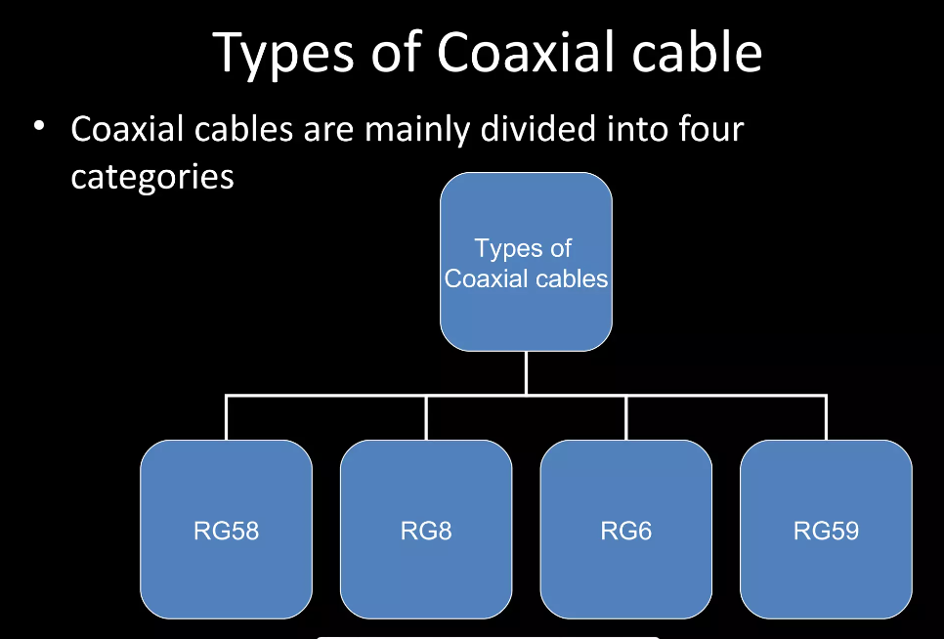
Types of Coaxial cables

Slide 7
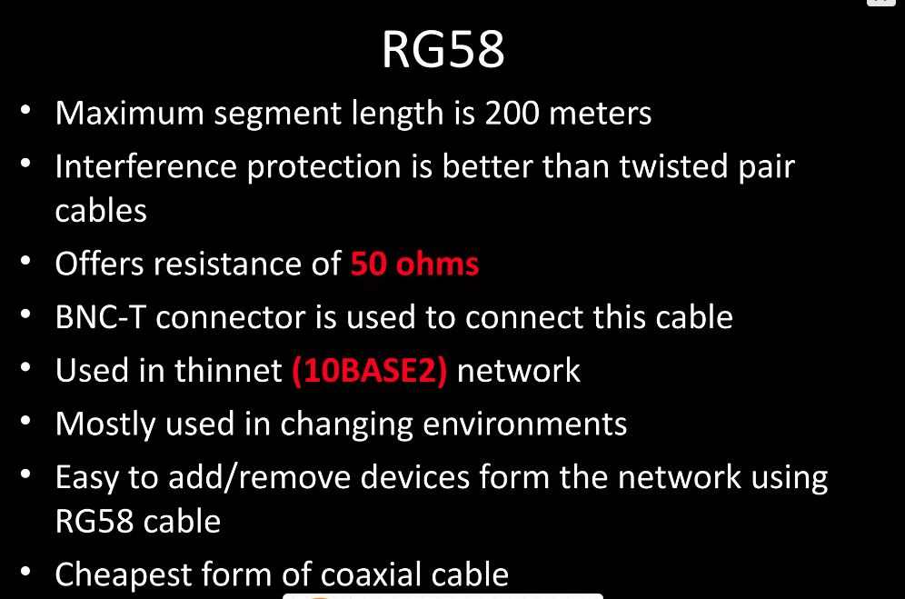
RG58

Slide 8
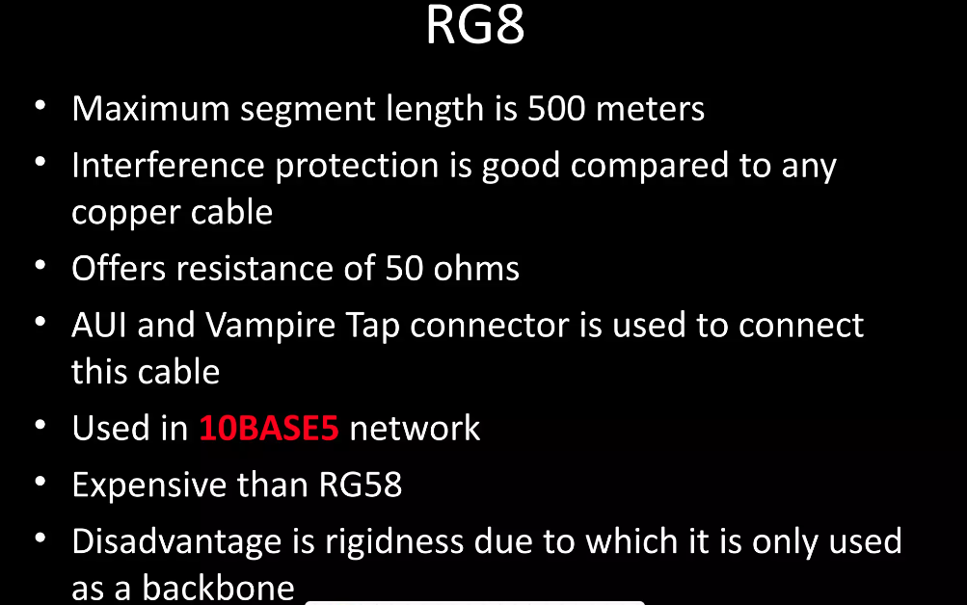
RG8

Slide 9
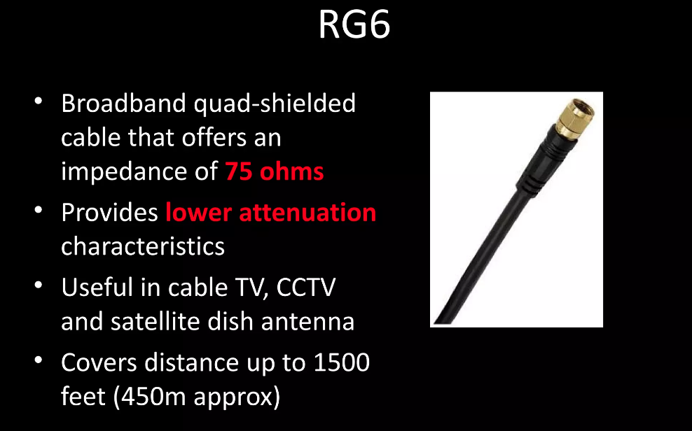
RG6

Slide 10
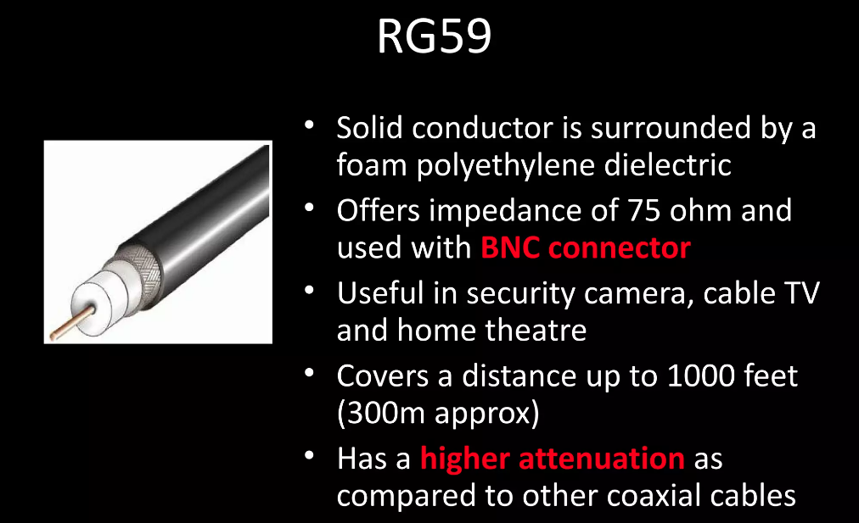
RG59

Slide 11
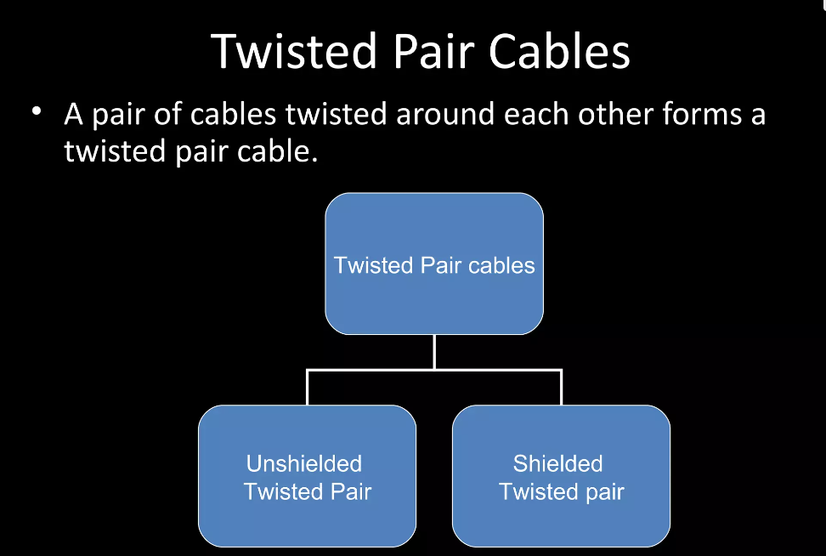
Twisted pair cables
Twisted pair cables consist of pairs of insulated copper wires twisted together, reducing electromagnetic interference and crosstalk, commonly used in telecommunications for transmitting data signals.

Slide 12
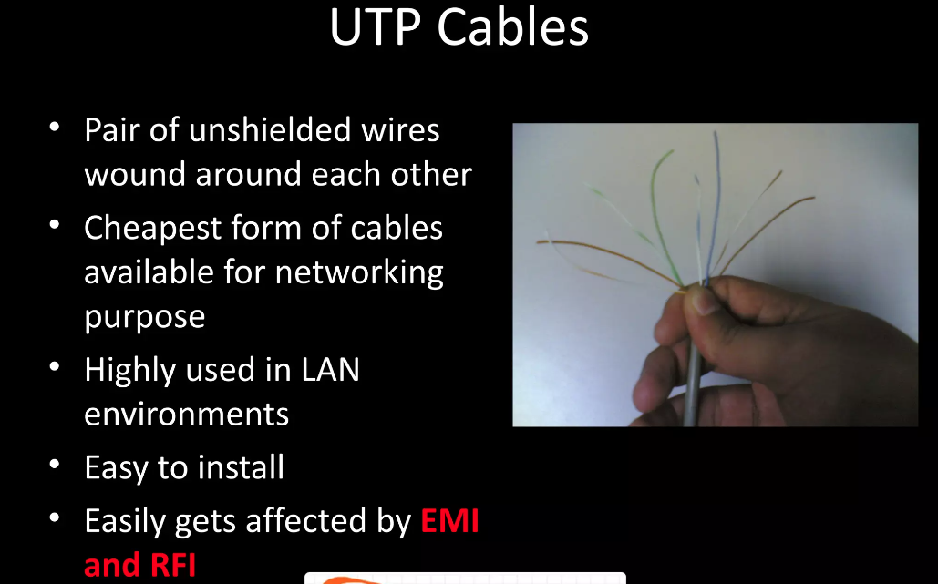
UTP

Slide 13
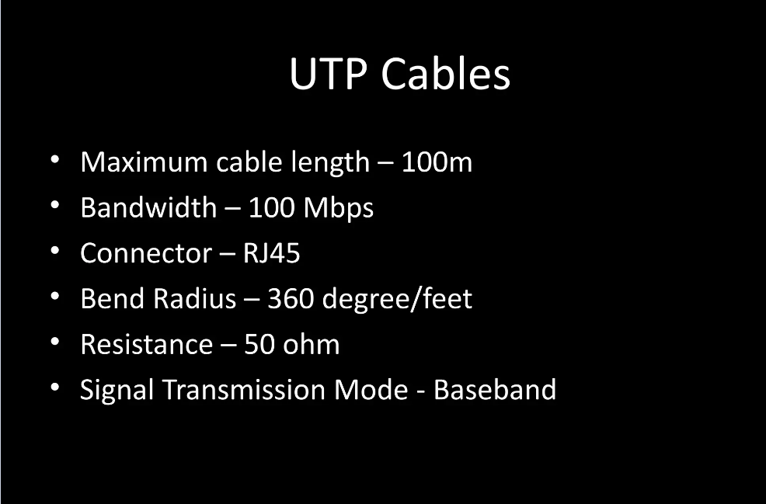
UTP

Slide 14
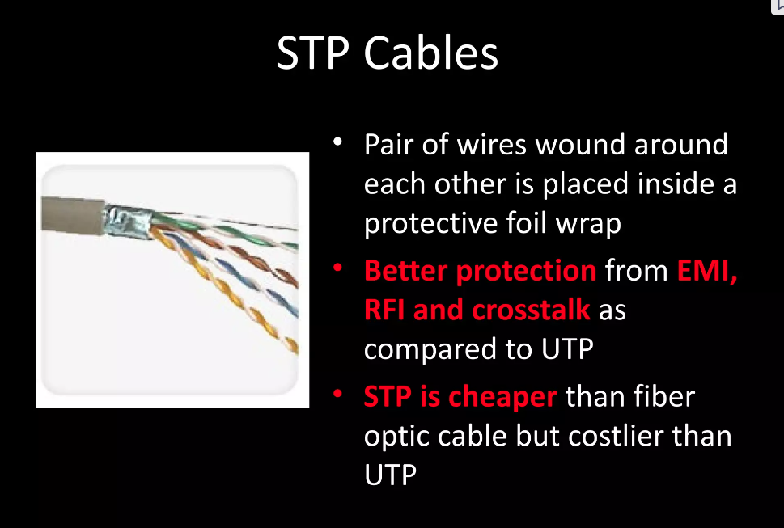
STP

Slide 15
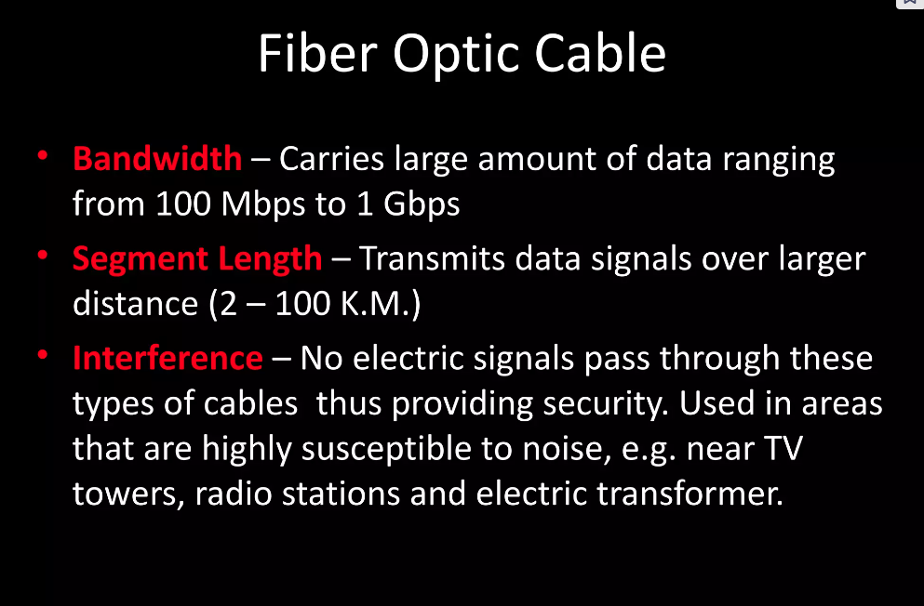
Fiber optic cable
Fiber optic cables are composed of strands of glass or plastic fibers that transmit data as pulses of light, offering high-speed, long-distance communication with minimal signal degradation, widely used in telecommunications and networking.

Slide 16
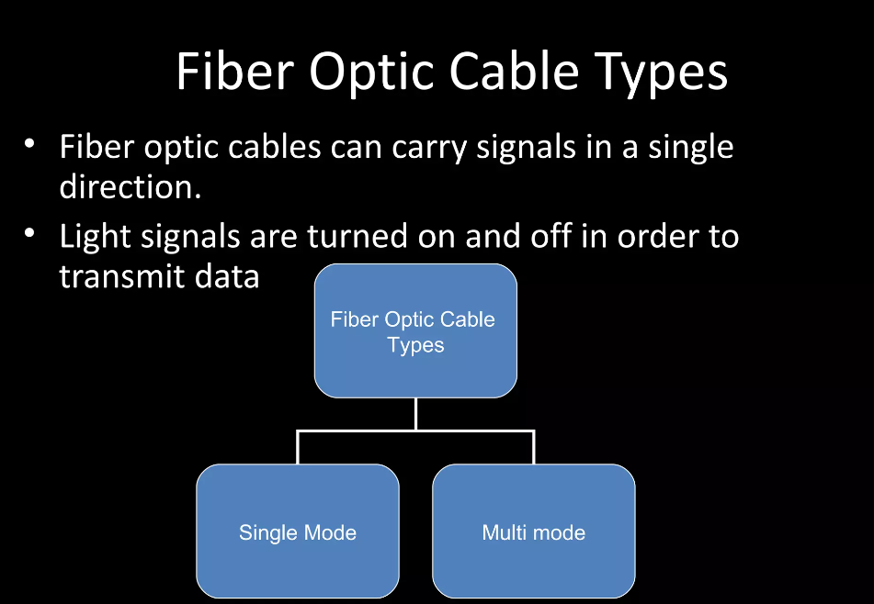
Types

Slide 17
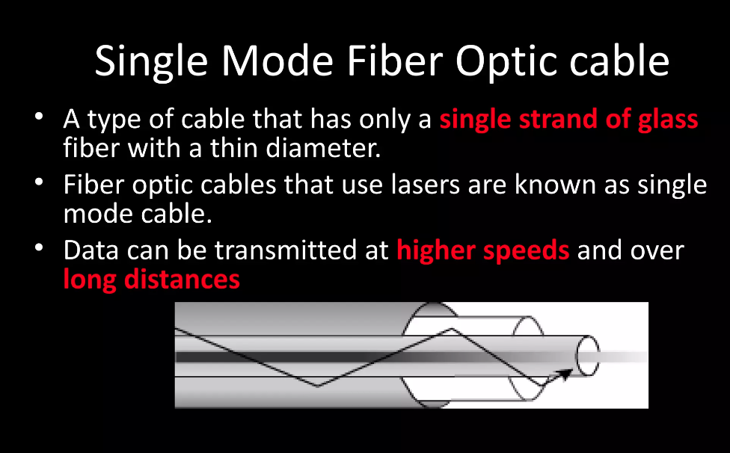
Single mode

Slide 18
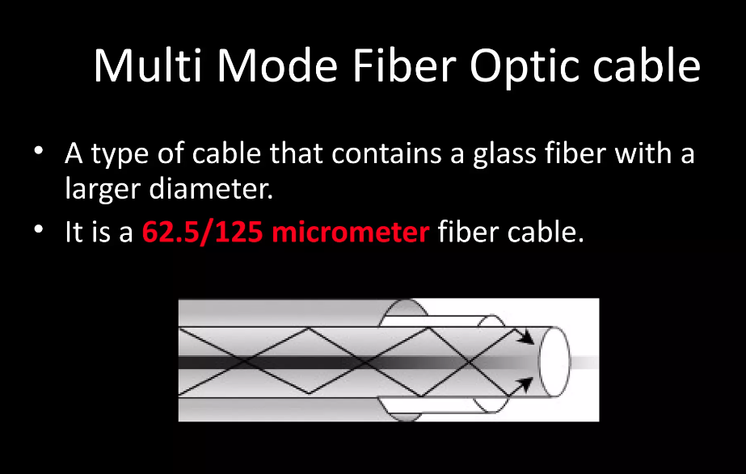
Multi mode

Slide 19
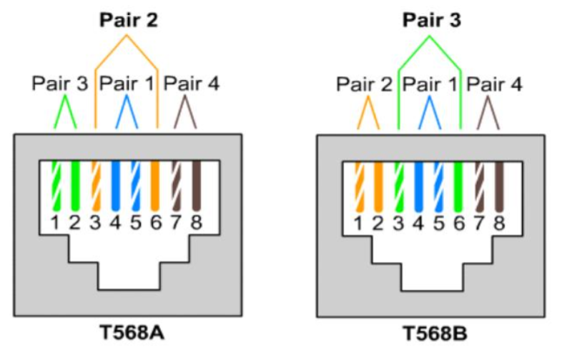
Cabling Standard
There are two network cabling standards in computer networking:
T568A and T568B
It is composed of four colors:
Orange
Green
Blue
Brown

Slide 20
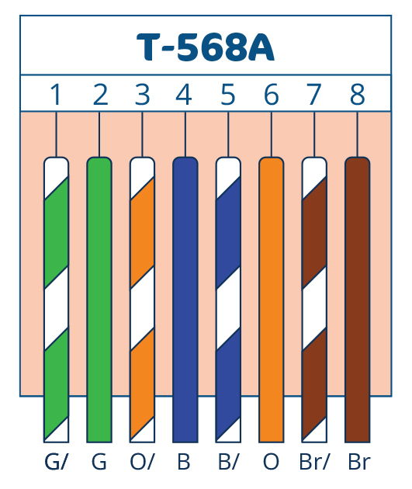
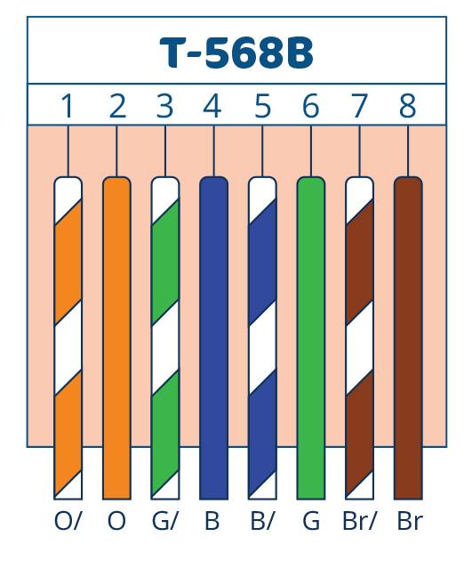
Cabling Standard
T568A
T568B
All the wires are connected to the same pin except for the green and orange wire.
Green wire is connected to pin two
Orange wire is connected to pin six
All the wires are connected to the same pin except for the green and orange wire.
Green wire is connected to pin six
Orange wire is connected to pin two
Notes:
The blue wire also referred to as the neutral wire, has the function of transferring electricity away from the appliance. The brown wire, otherwise known as the live wire, transfers electricity to the appliance. The combination of these wires is referred to as a circuit

Slide 21
Ethernet Cables
Ethernet cable refers to a type of networking cable commonly used to connect devices in a local area network (LAN). It typically consists of twisted pairs of copper wires encased in an insulating sheath, with variations such as Cat5e, Cat6, and Cat6a offering different levels of performance and bandwidth. Ethernet cables facilitate the transmission of data between computers, routers, switches, and other network devices using Ethernet networking standards.
There are two types of Ethernet cables:
Straight-through
Used to connect devices belong to different group
Same cabling standard for both end.
Cross-over
Used to connect devices belong to same group
Different cabling standards for both end

Slide 22
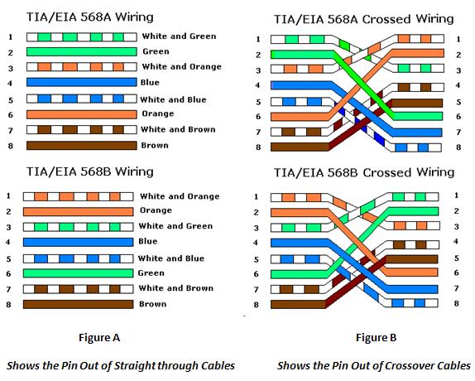
Straight-through and cross-over

Slide 23
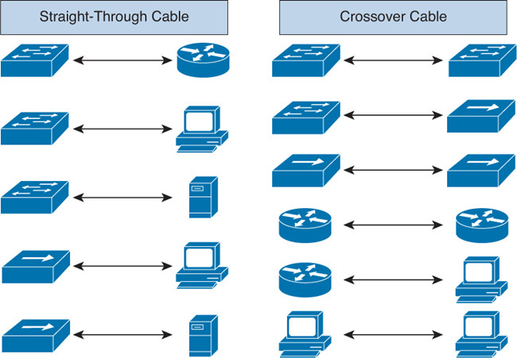
Families of devices
Group 1
PC
Router
Group 2
Switch
Hub

Slide 24
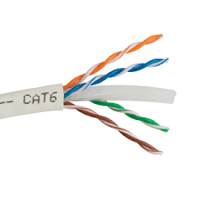
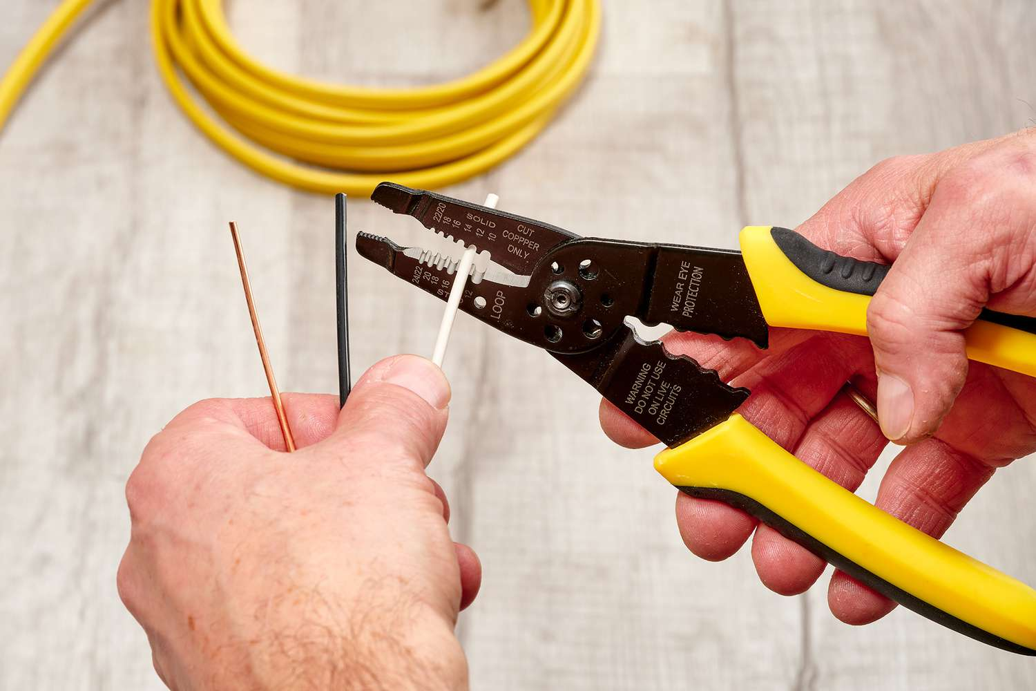
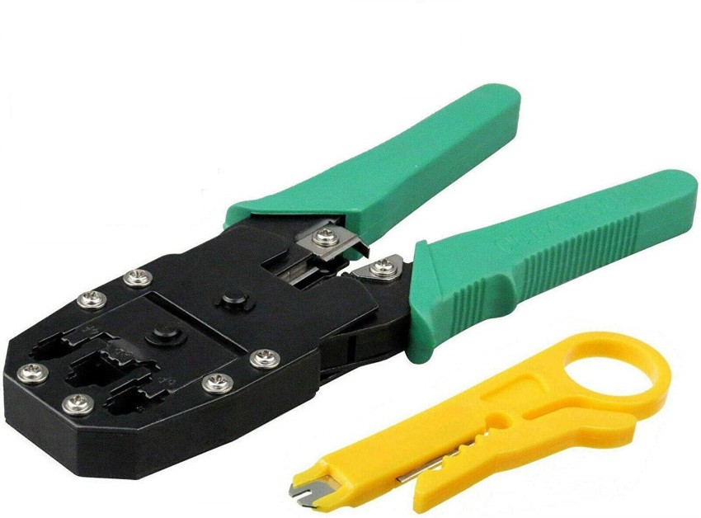
Tools for cabling
Cat6 cable
RJ45 connectors
Cable stripper
Scissors
Crimping tool

Slide 25
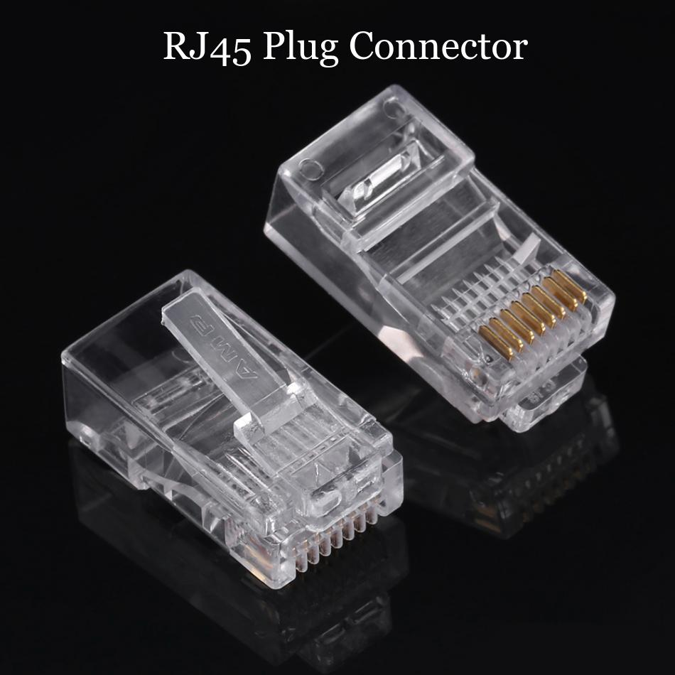
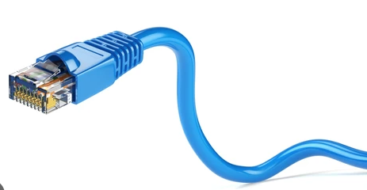
Connector
RJ45 is a type of connector commonly used for Ethernet networking. The "RJ" in RJ45 stands for "registered jack," since it is a standardized networking interface. The "45" simply refers to the number of the interface standard.
Each RJ45 connector has eight pins, which means an RJ45 cable contains eight separate wires. If you look closely at the end of an Ethernet cable, you can actually see the eight wires, which are each a different color. Four of them are solid colors, while the other four are striped.
RJ45 cables can be wired in two different ways. One version is called T-568A and the other is T-568B.

Slide 26
Cat6
Cat6 cable, short for Category 6 cable, is a type of twisted pair Ethernet cable used in network infrastructure to support high-speed data transmission. It provides performance up to 250 MHz and is capable of delivering data speeds of up to 10 Gbps over distances of up to 55 meters, making it suitable for Gigabit Ethernet and some 10 Gigabit Ethernet installations.

Slide 27
Cable stripper
A cable stripper is a hand tool used to remove the outer insulation or sheathing from electrical cables or wires. It typically consists of a handle and a blade or cutting mechanism designed to cleanly cut through the insulation without damaging the inner conductors. Cable strippers are commonly used in electrical and networking applications to prepare cables for termination or connection to devices, ensuring proper electrical contact and signal transmission.

Slide 28
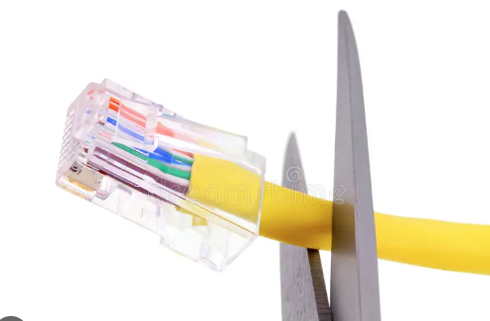
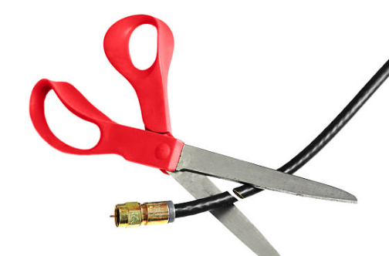
scissors
"scissors" typically refer to a specific type of tool used for trimming excess wires during the termination process of Ethernet cables. These scissors are designed with precision blades to ensure clean cuts without damaging the conductors. They are commonly used alongside other tools like crimpers and cable strippers to properly prepare and terminate Ethernet cables for connection to networking devices such as switches, routers, and patch panels.

Slide 29
Crimping tool
A crimping tool, in the context of network connectors, is a specialized tool used to attach connectors (such as RJ45 connectors for Ethernet cables) to the ends of network cables. It typically consists of a pair of handles, a crimping mechanism, and interchangeable dies or jaws designed to compress the connector onto the cable's wires securely. Crimping tools ensure proper termination of cables, providing reliable electrical contact between the conductors and the connector pins. They are essential for creating custom-length Ethernet cables and maintaining the integrity of network connections.

